Slide 1
SHADER EFFECTS

Slide 2
INTRODUCTION
Shader effect is the algorithm that is written in shading language (GLSL which is like C language but not C).
Shader effects allow us to manipulate vertices and pixels directly, and specify how each pixel of an object should render on the screen
Shader effects are applied to GUI elements of Qt/QML to modify their appearance and behaviour
Shader effects allow us to manipulate colours, distort shapes, create animations, blur...
All effects are executed directly on the GPU to make them fast and efficient

Slide 3
SHADERS TYPES
There are 3 Types of shaders
Vertex Shader
Geometry Shader
Fragment Shader

Slide 4
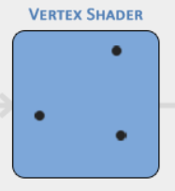
VERTEX SHADER
Vertex Shader: It works on Vertices individually and it runs for each vertex of primitives. It manipulates the vertices (x, y) coordinates using Translation(moving), Rotation(orientation), and Scaling(resizing).
Notes
Transforming the position of each vertex from its original coordinate into the clip space/screen space coordinates
Primitives are basic shapes (Line, Triangle, Circle)

Slide 5
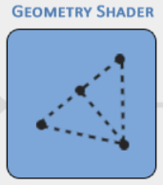
GEOMETRY SHADER
Geometry Shader: Processes The primitives before they are rasterized into pixels. Primitives are basic geometric shapes defined by vertices. geometry shader receives these primitives as input and modifies the primitives based on conditions and criteria.

Slide 6
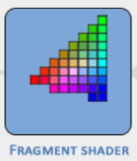
FRAGMENT SHADER
Fragment Shader (Pixel Shader): The fragment shader operates on each fragment/pixel individually and calculates the final colour, lighting, shading effects and appearance of that fragment.
Notes
Main task of the Fragment shader is to sample the texture coordinates (UV) and apply (wrap) them to the geometry (Surface)
Each pixel contains the information about its position, depth, texture coordinates

Slide 7
GRAPHICS PIPELINE
The graphics pipeline refers to the sequence of stages through which graphical data is processed to render images/objects on a screen or display device.
Input Assembly
Vertex Shader
Rasterization
Fragment Shader
Colour Blending
Frame Buffer
Fixed Function
Programmable

Slide 8

GRAPHICS PIPELINE
Input assembly
For gathering raw input data, which typically includes vertices and their associated attributes (such as positions, and texture coordinates).
The input raw data is organized into primitives, such as points, lines, or triangles.

Slide 9

GRAPHICS PIPELINE
Vertex Shader
The Vertex Shader operates on each vertex of the primitives, and it performs operations like transformation, rotation, and scaling on positions of vertices.
The output of the vertex shader is transformed vertex positions

Slide 10

GRAPHICS PIPELINE
Rasterization
This stage converts the primitive’s vertex into fragments (pixels)
It uses the interpolation process for generating the fragments in between the vertex attributes.
Each fragment includes attributes such as texture coordinates, normals, colour

Slide 11

GRAPHICS PIPELINE
Fragment Shader
The fragment shader operates on each fragment and it determines the final colour of each fragment by performing the texture sampling, lighting calculations, shading and various effects.
Output of the fragment shader is the final fragment colour, position and depth

Slide 12

GRAPHICS PIPELINE
Colour Blending
It is the process of combining the colour of the fragment with the colour that is already available in the frame buffer using some blending equations

Slide 13
GRAPHICS PIPELINE
Frame Buffer
It is the area of memory where the final image is stored, and after color blending final color values are written to the frame buffer

Slide 14

GRAPHICS PIPELINE
Finally, frame buffer is displayed on the screen

Slide 15
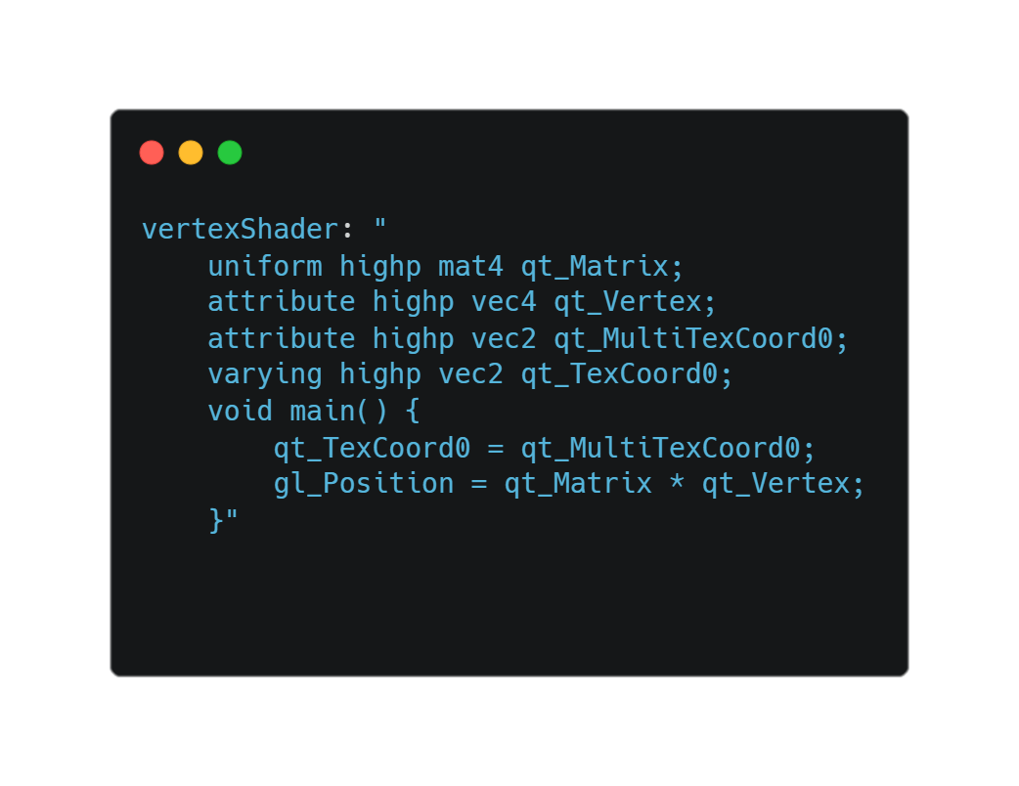
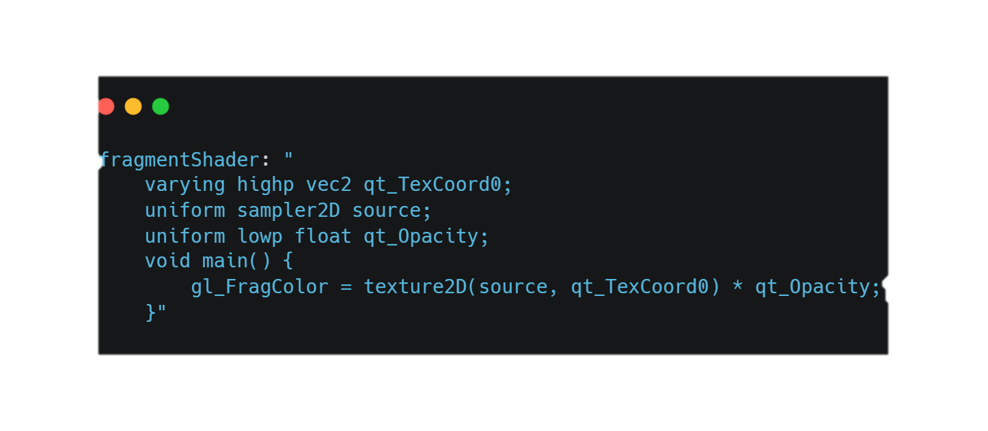
VERTEX & FRAGMENT SHADER MINIMAL CODE

Slide 16
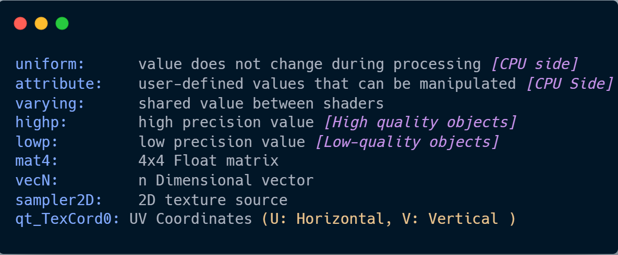
VERTEX & FRAGMENT SHADER MINIMAL CODE

Slide 17
QUESTION & ANSWERS
Q1: Can we use vertex shader instead of fragment shader to achieve the zooming effect?
A1: In a Vertex shader, we manipulate the positions of the vertices of primitives, using scaling or transforming the geometry itself. This can create a zoom effect by adjusting the size or position of objects on the screen.
Meanwhile, a Fragment shader can't directly change the size or position of objects like a vertex shader, but it can apply various effects on individual pixels to achieve a zoom, such as appearance, and colour of pixels.
Conclusion:
a) If we want to zoom in or zoom out the entire display or specific elements uniformly, vertex shader can be used there
b) If we want to apply more complex effects like magnification, distortion or blurring of specific regions of the screen or specific elements, fragment shader can be used there

Slide 18
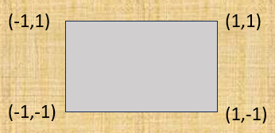
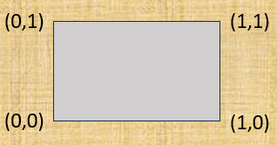
QUESTION & ANSWERS
Q2: Difference between the position coordinates and UV coordinates
Position coordinates [Vertex] refer to the location of vertices in 3D space
These coordinates are often represented to (x,y,z,w)
The Range of position coordinates is -∞ to +∞ which gets normalized into -1 to +1 in clip space (after the vertex shader stage).
The range from -1 to +1 shows the position of points because they can vary from negative to positive values in 3D space
This normalization is useful for getting rid from complex calculations
UV coordinates [Fragement] are used to map the textures onto the 3D surface
Textures are often represented as 2D images and UV coordinates provide a way to map the points on a 3D surface to points on a 2D surface
UV coordinates are typically represented as (u,v) pair, where u, v values are normalized to the range [0,1]
UV coordinates are normalized to provide a consistent mapping between textures and surfaces

Slide 19
REFERENCES
https://qmlbook.github.io/ch11-shaders/shaders.html
https://learnopengl.com/

Slide 20
THANK YOU

Slide 21
LSM Compositor Window
Application Window
Video Window
Application global position
Video window position

Slide 22
m_compositorWindow
m_qwlsurfaceItem (Wayland surface item -> Client)
m_exportedItem (video window item with surface item)
m_surfaceGlobalPosition (Location of application on compositor window)
m_originalRequestedRegion (Video output request location in Application)

